Slide 1
Drawing 1,Arts 1316
Susan Harmon, Professor
Central Texas College, Fort Hood

Slide 2
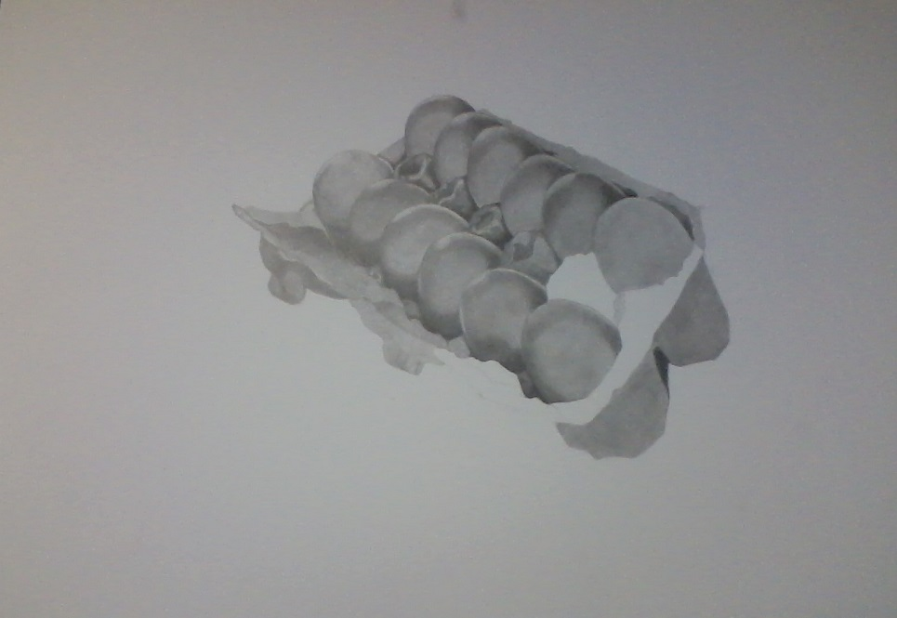
Week 1- Egg Drawing, from actual eggs, with pencil

Slide 3
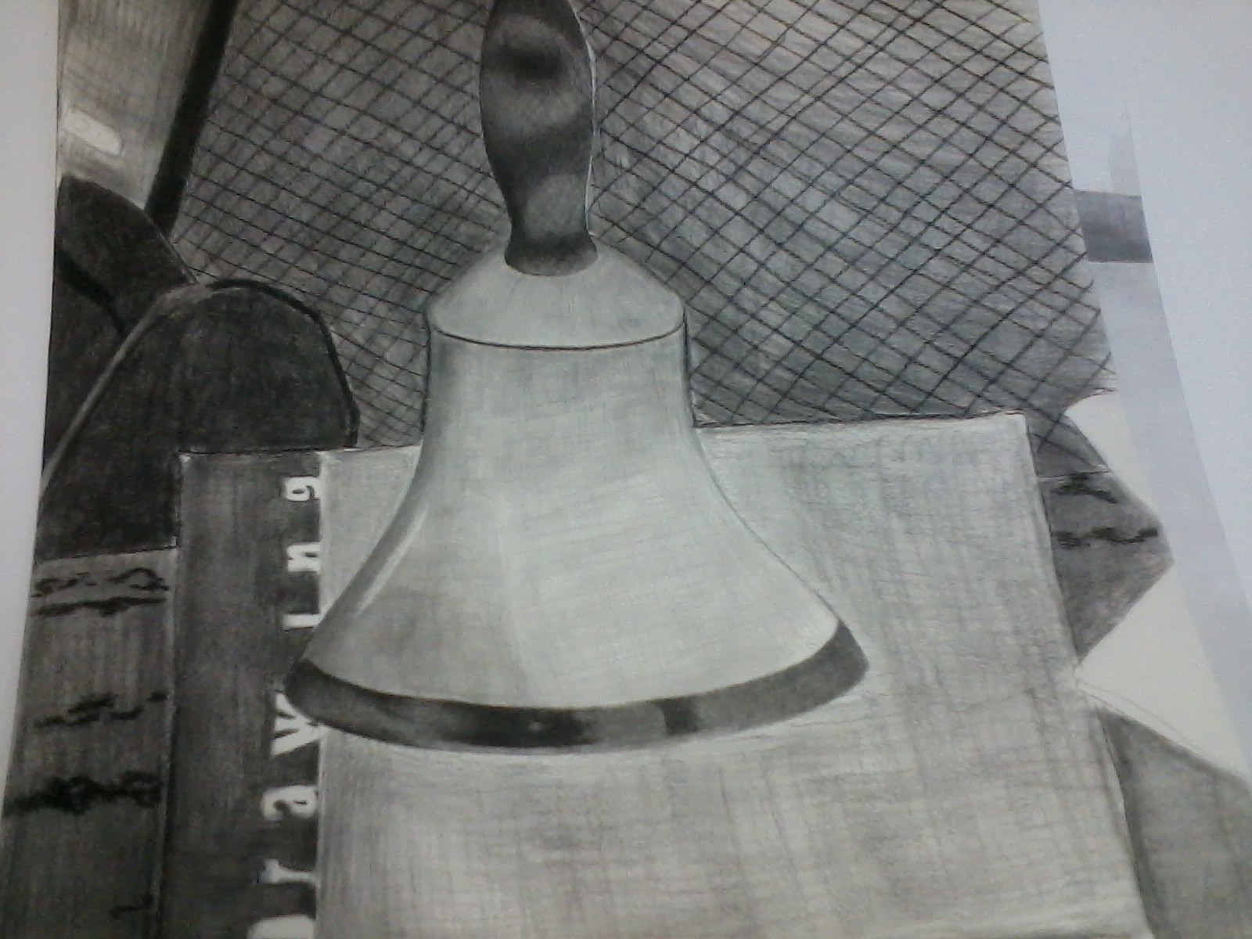
Week 1-Still-life from actual objects with charcoal

Slide 4
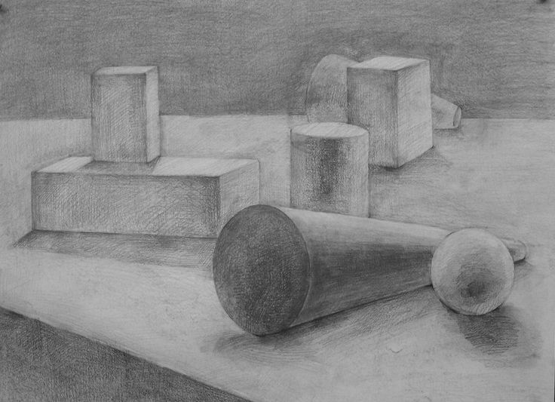
Week 2-Another example of Still life with charcoal

Slide 5
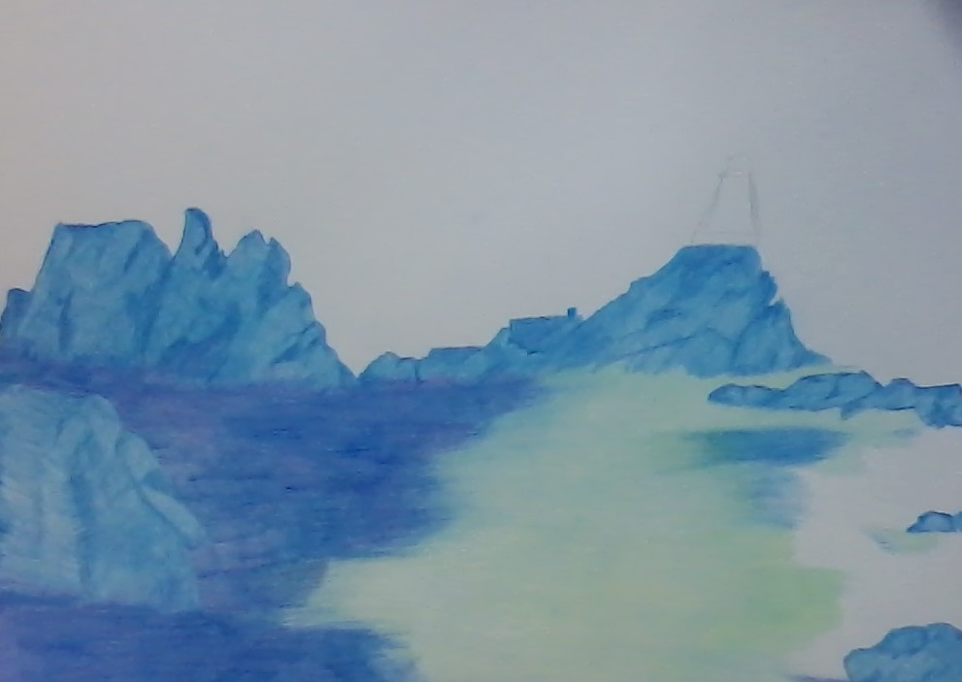
Week 2- Landscape, from photo, with colored pencil

Slide 6
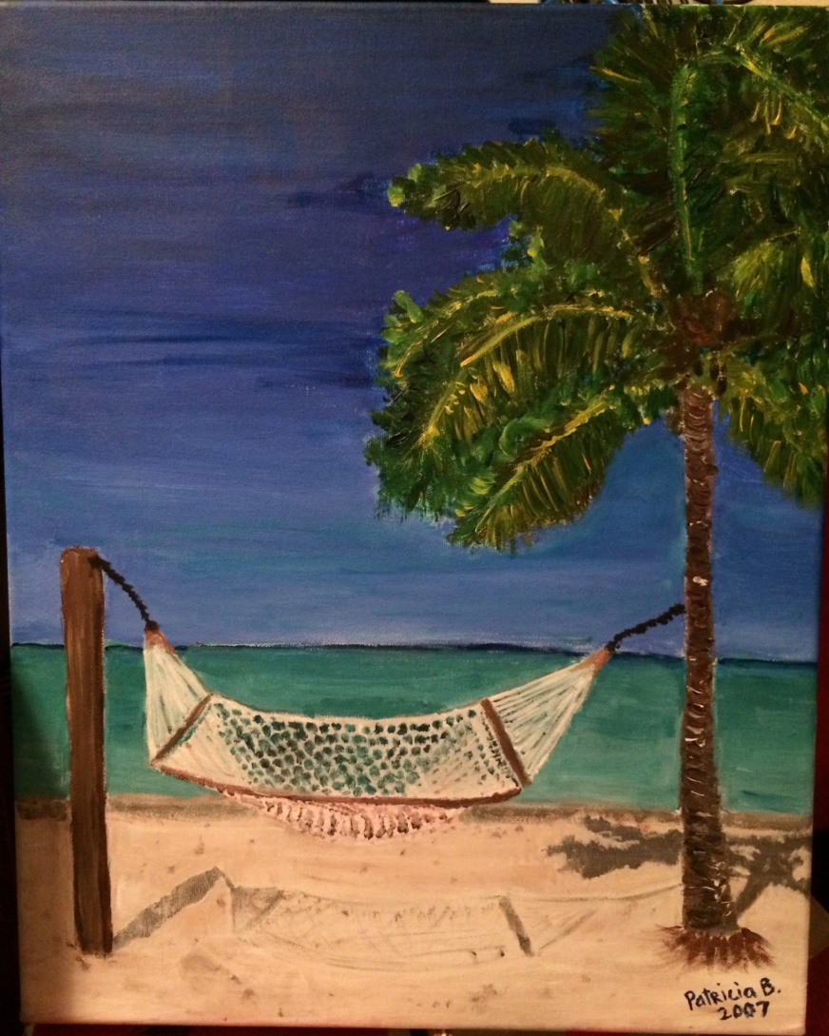
Week 2-Landscape,on location, with color pencil

Slide 7
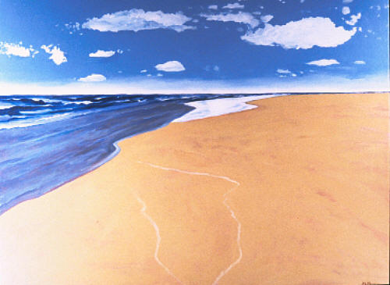
Seascape from photograph

Slide 8
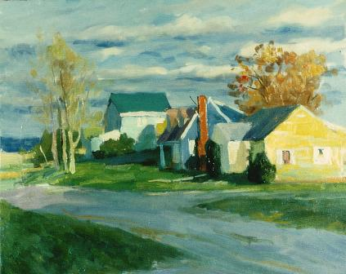
Landscape from on location

Slide 9
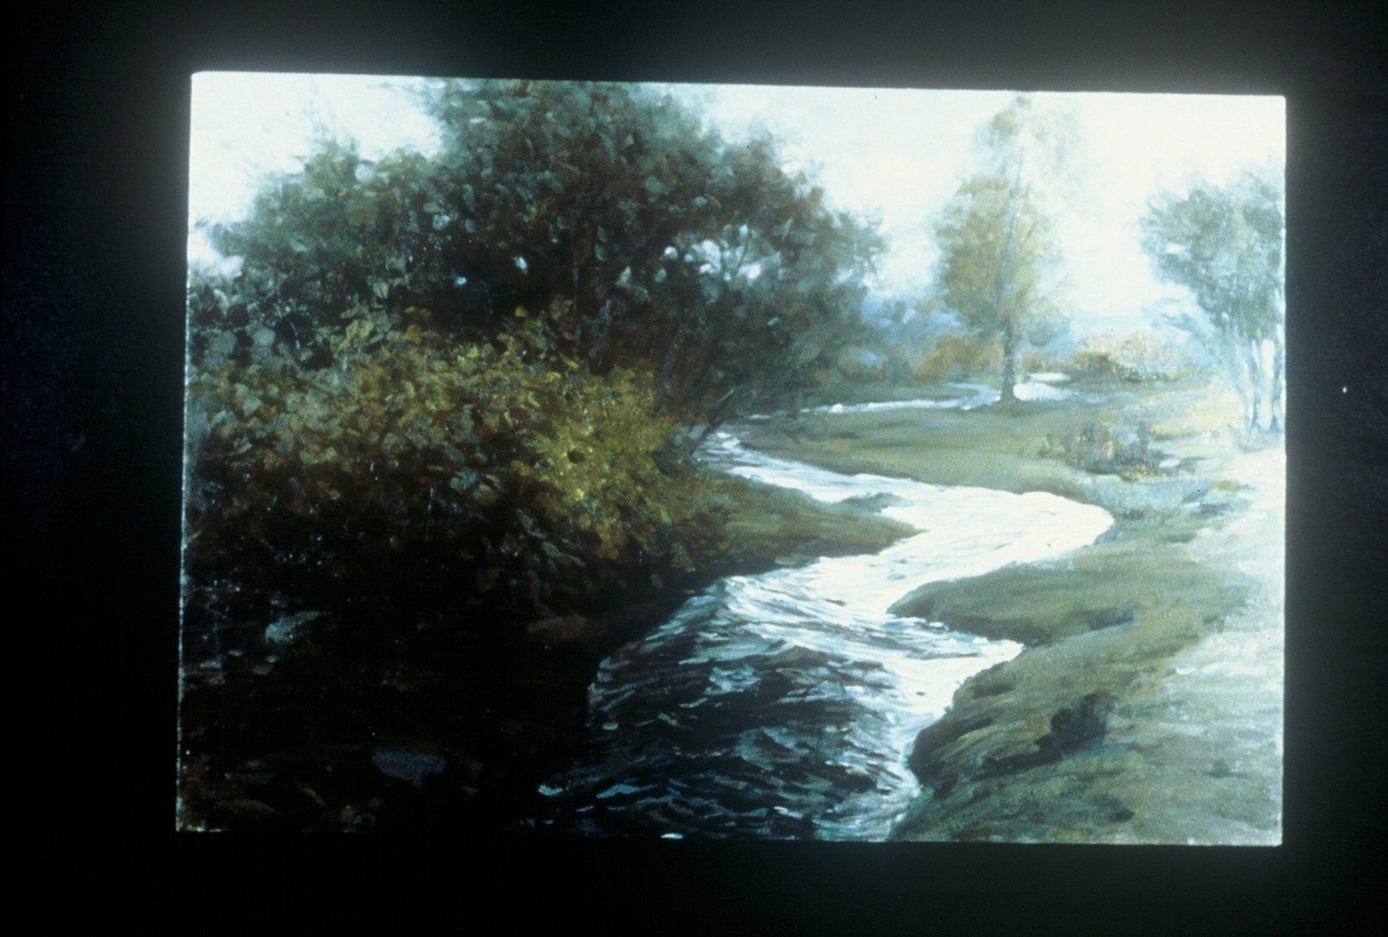
Landscape on location

Slide 10
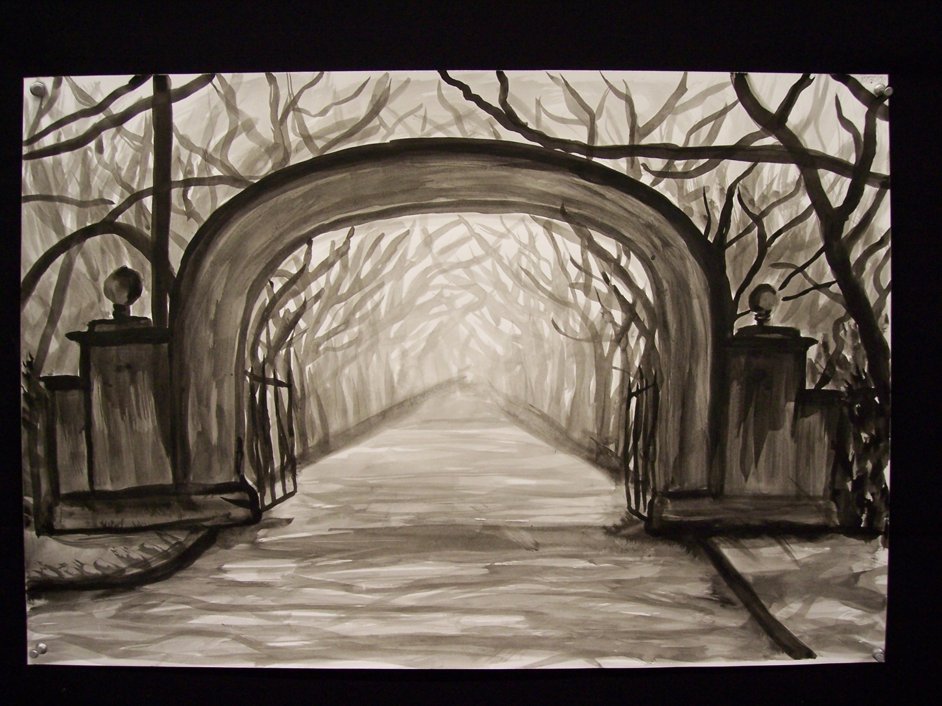
On location

Slide 11
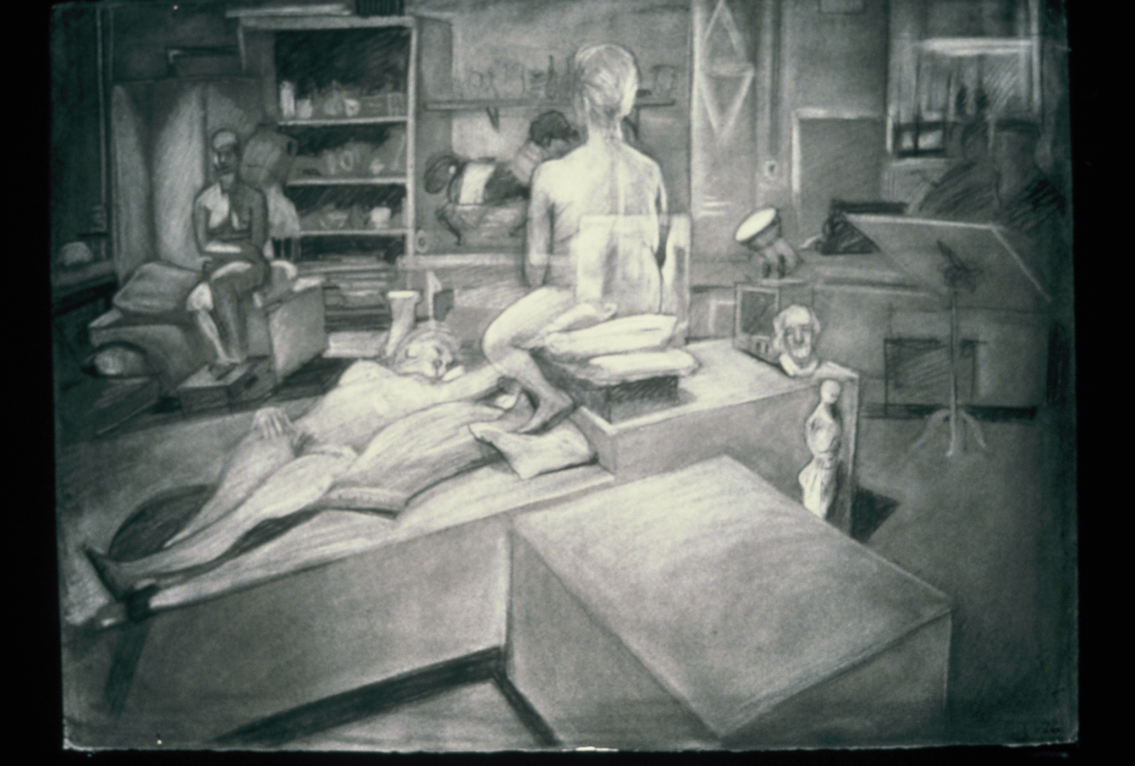
Week 3-Interior Space with black white chalk pastel

Slide 12
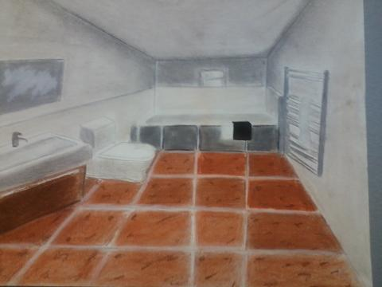
Interior space with colored chalk pastel

Slide 13
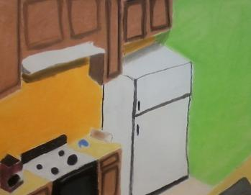
Interior with color chalk pastel

Slide 14
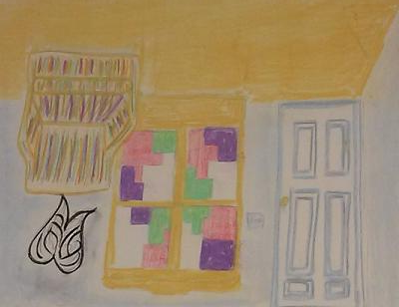
Interior with chalk Pastel

Slide 15
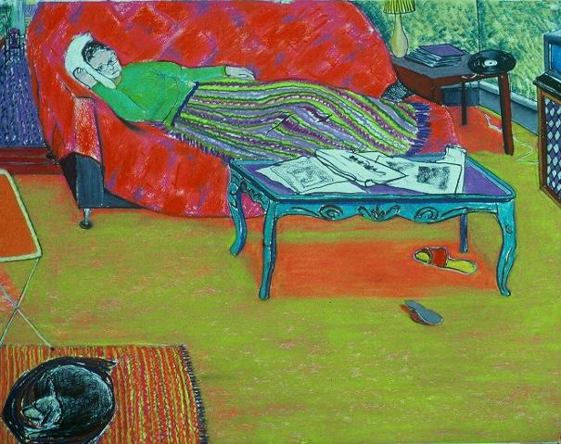
Week 3-Interior space with color pastel chalk

Slide 16
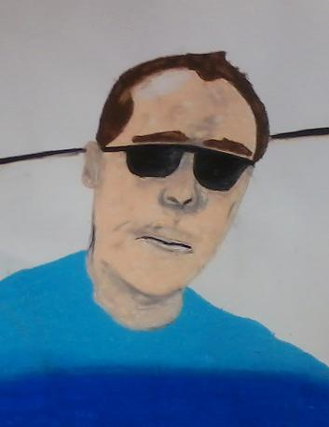
Week 4-Live Portraits with oil pastel

Slide 17
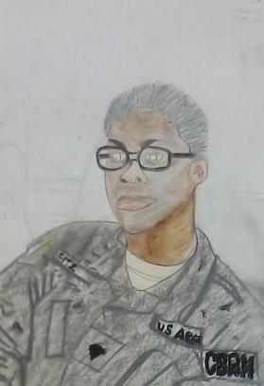
Self portrait with oild pastel

Slide 18
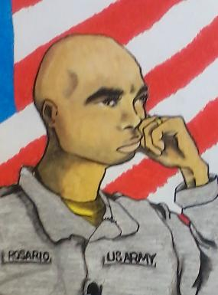
Portrait with Oil Pastel

Slide 19
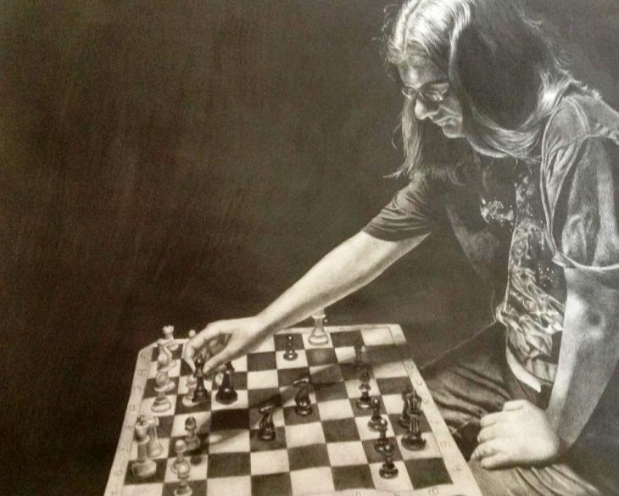
Week 4-self portrait,using a mirror with oil pastel

Slide 20
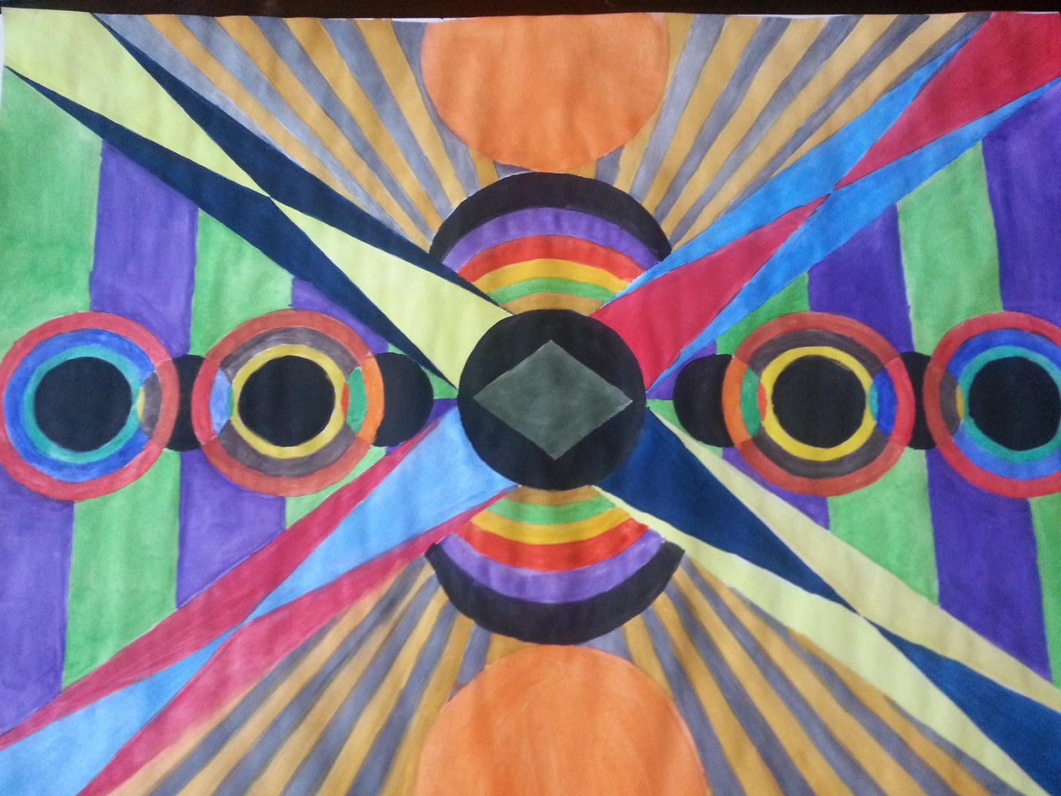
Week 5-Non objective designs-geometric shapes with collage

Slide 21
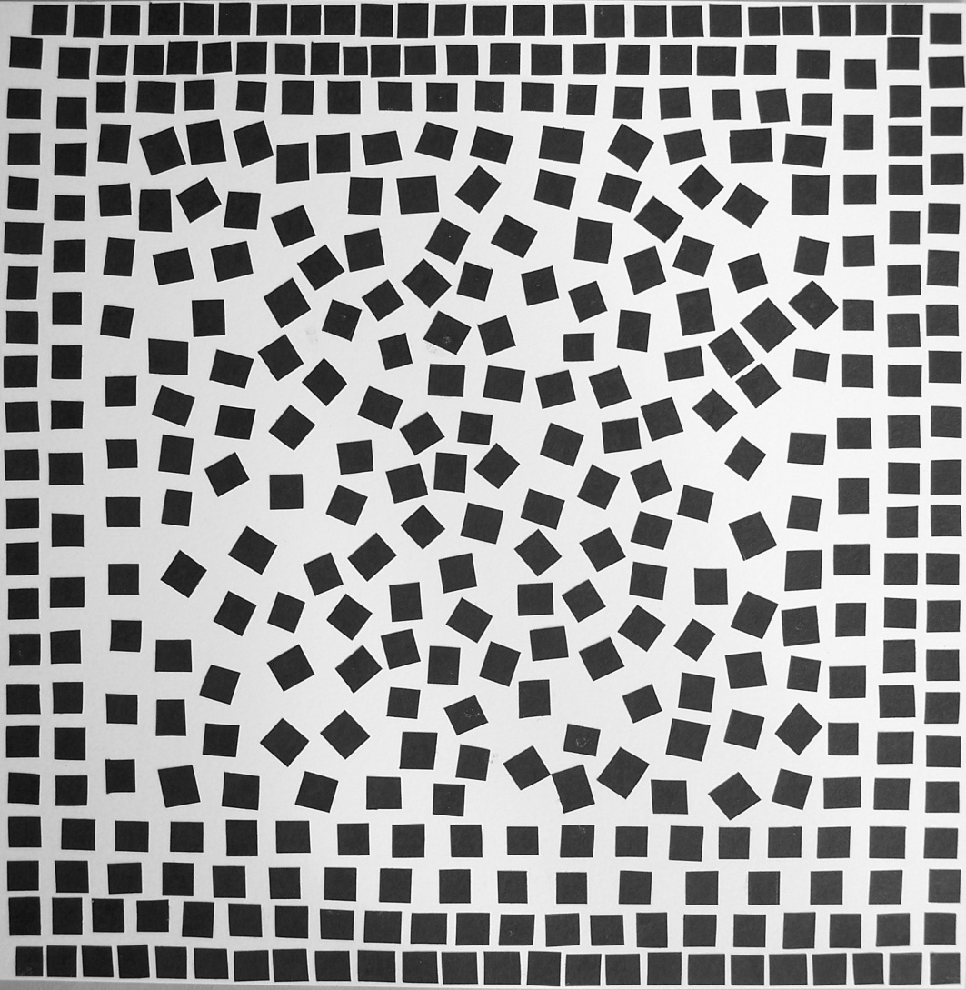
Geometric design with collage

Slide 22
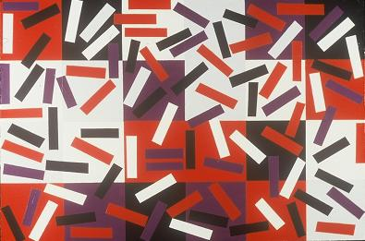
Geometric design with collage

Slide 23
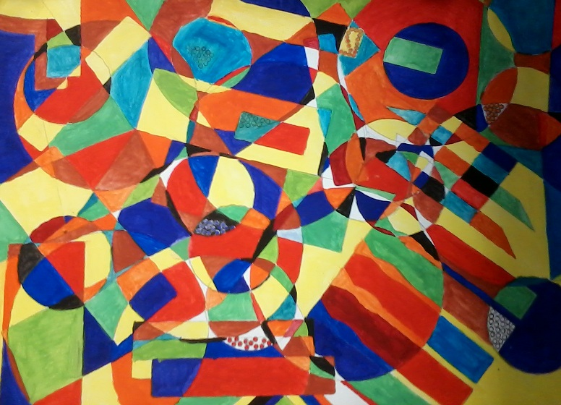
Geometric design with water color

Slide 24
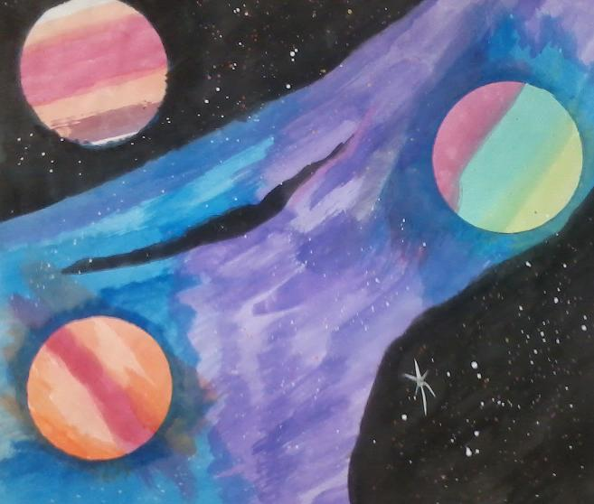
Week 5-Non objective designs with organic shapes with collage

Slide 25
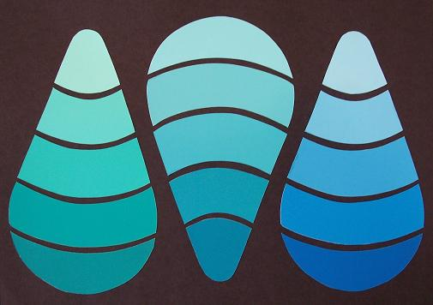
Organic design with collage

Slide 26
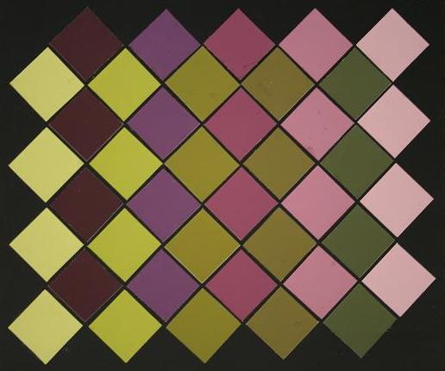
Geometric designwith collage

Slide 27
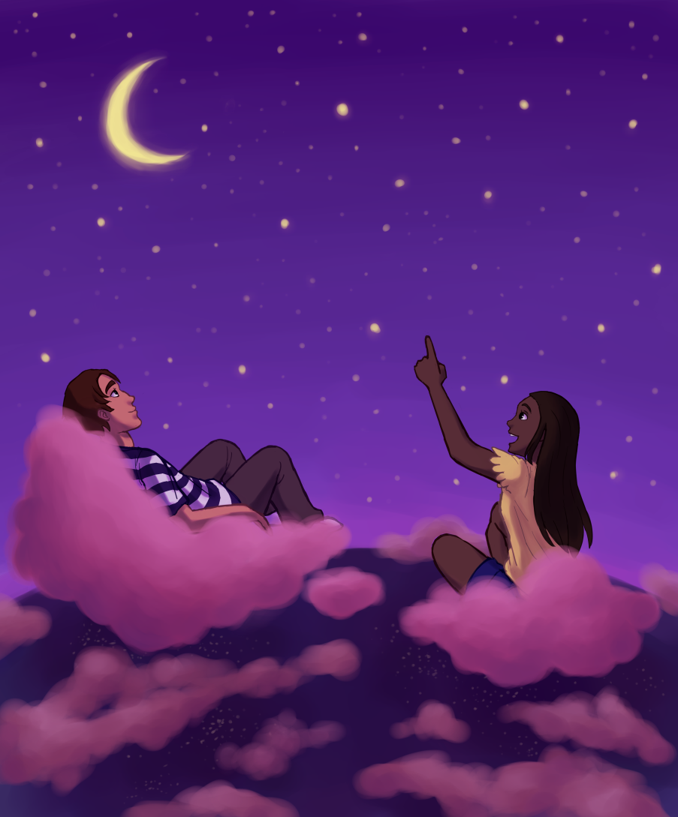
Week 6-Diptych,Surrelatsic
DreamScape with watercolor,Surrealist artist paper ,1 page

Slide 28
Week7-Mount Dreamscape, write an artist statement about dreamscape and create a power point with all of your work,in chronological order from this course for a final presentation.

