Slide 1
INTRODUCTION For Art2311 Art For Elementary Teachers
My name is Susan Harmon

Slide 2
I want to teach because:
I love sharing my passion of art with younger people.
I enjoy spending time with younger people.

Slide 3
My art experience is:
I have been making art since I was 7 years old
I have been teaching art for 20 years
I have several art Degrees: BFA, The school of the Art Institute of Chicago, BFA The university of Illinois.MFA Georgia Southern University

Slide 4
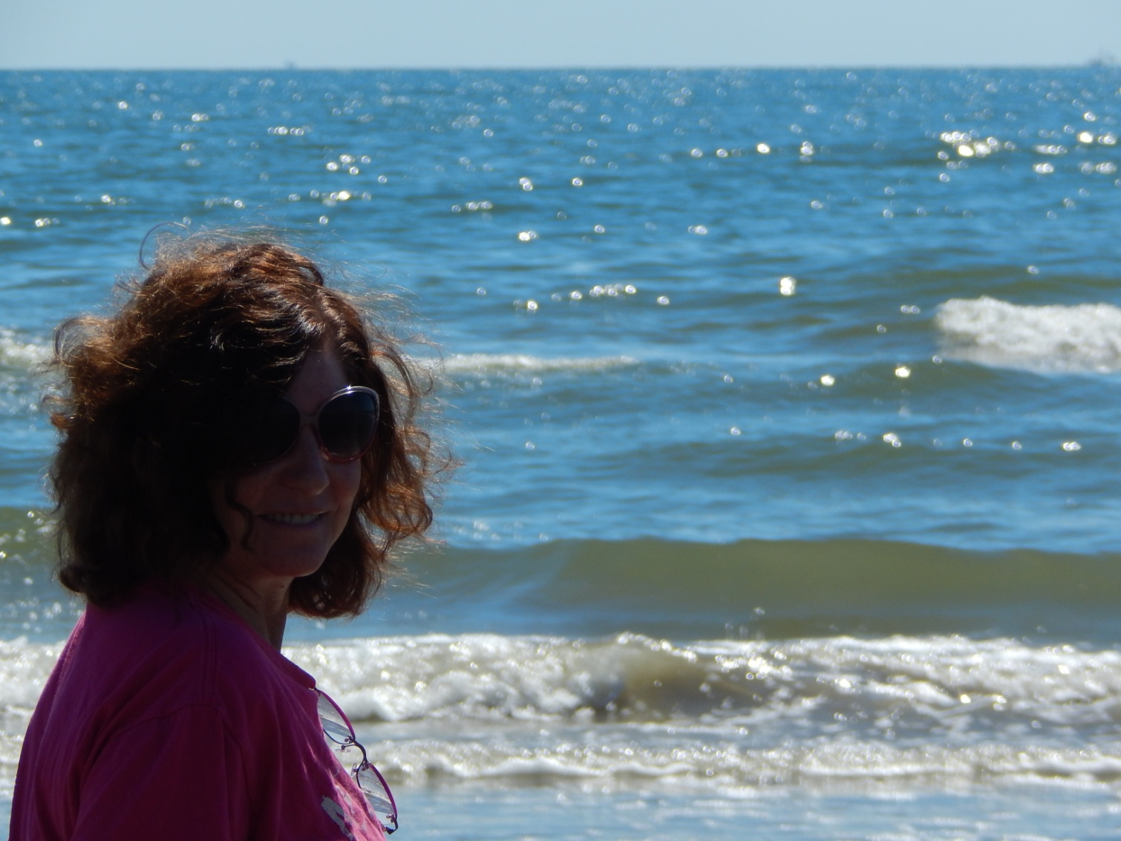
This is a photo of me at my favorite place, Corpus Christy

Slide 5
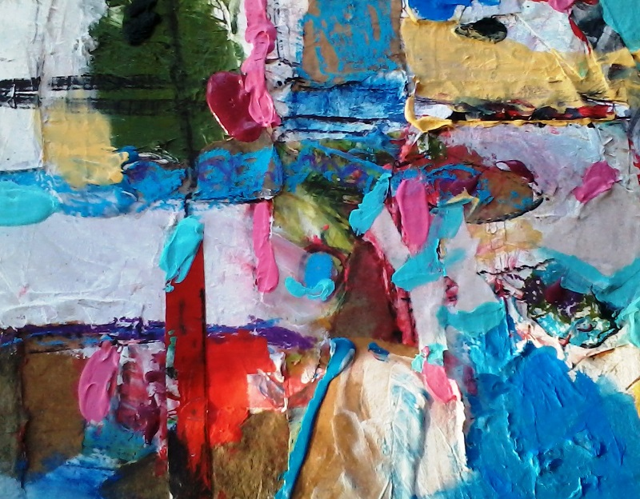
This is a sample of my art called DETRITUS 1

