Slide 1
Henry Matisse
Candace Montgomery

Slide 2
Biography
He was born in northern Italy close to the Belgian border
He discovered he wanted to be an artist when his mother brought him art supplies during his healing process from appendicitis in 1889.
He started painting still lives and landscapes.
He developed the process of reading poetry before picking up a brush.
In 1941 he was diagnosed with cancer, then had a surgery leaving him in a wheelchair which led to his paper cut out collages.

Slide 3
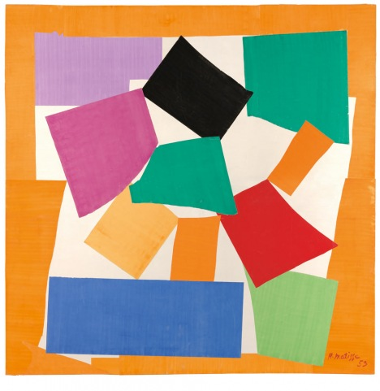
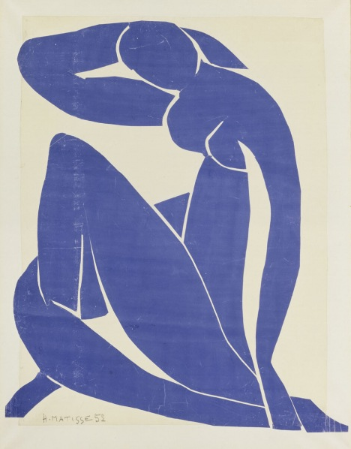
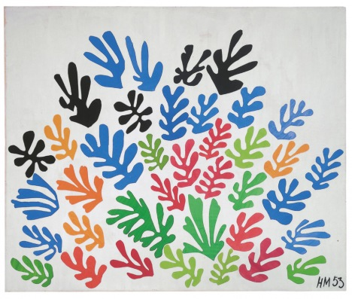
Cut Paper Collages
Matisse would cut painted sheets into forms of varying shapes and sizes which he then arranged into collages. Initially, these compositions were modest in size but, over time, their scale grew along with Matisse’s ambitions for them, expanding into mural or room-size works.

Slide 4
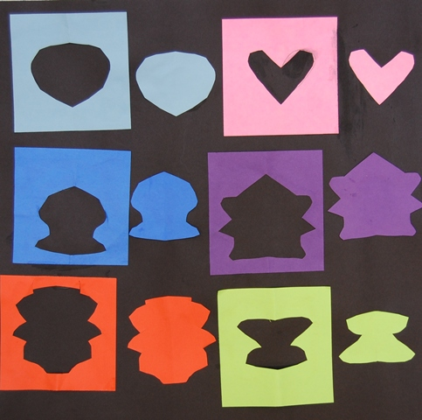
Vocabulary
Positive cut out: the part that you actually cut out.
Negative cut out: the part around what you actually cut out.

