Slide 1
BLAME WORTHINESS#1-9
This series was inspired by stories about people who suffer from mental illness, influenced by Outsider Art and placing emphasis on emotional mark making.

Slide 2
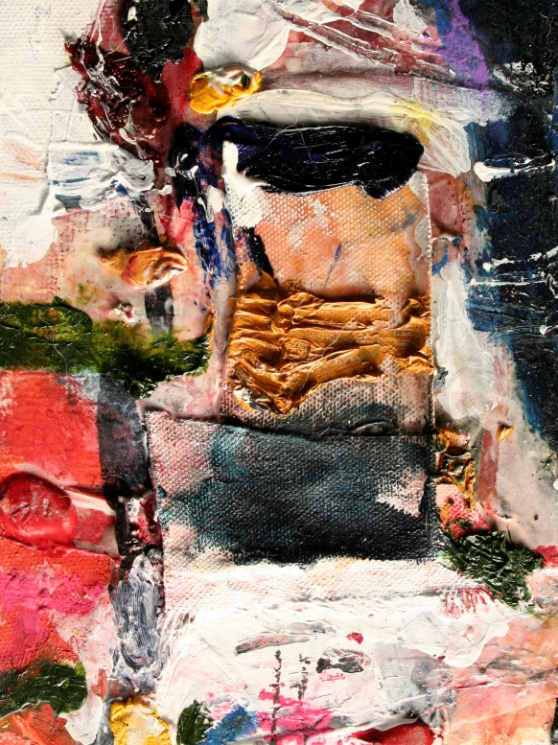
blame worthiness #1

Slide 3
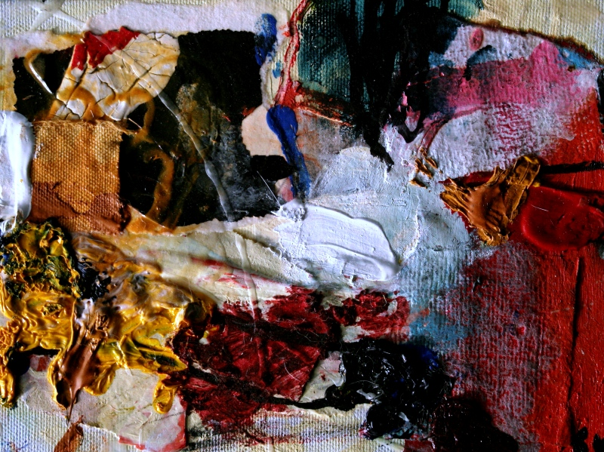
blame worthiness #2

Slide 4
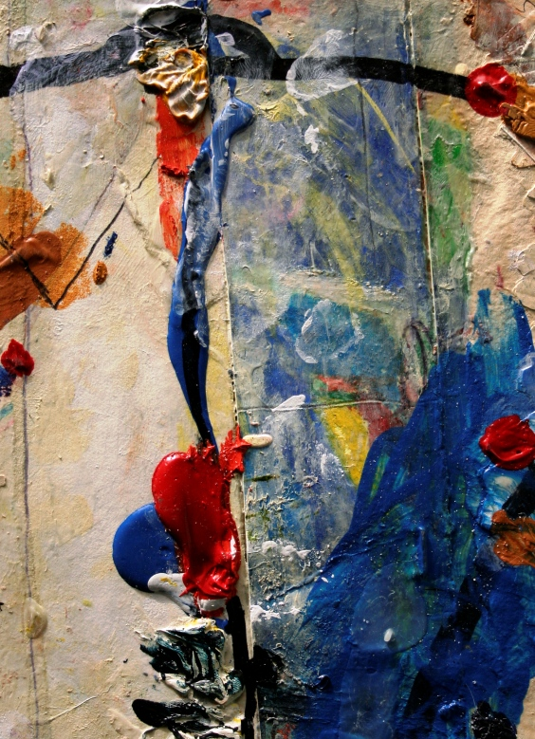
blame worthiness #3

Slide 5
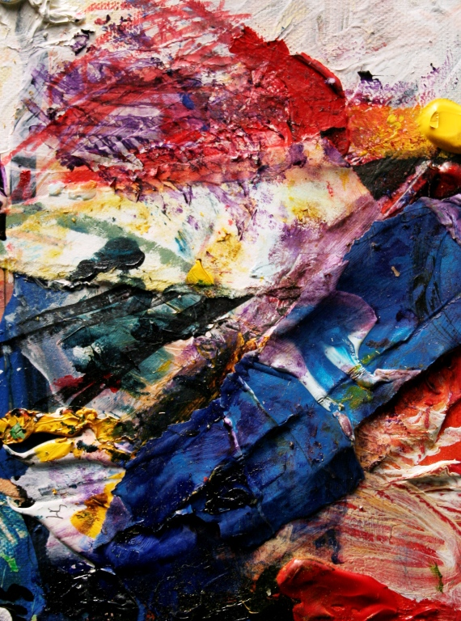
Blame worthiness #4

Slide 6
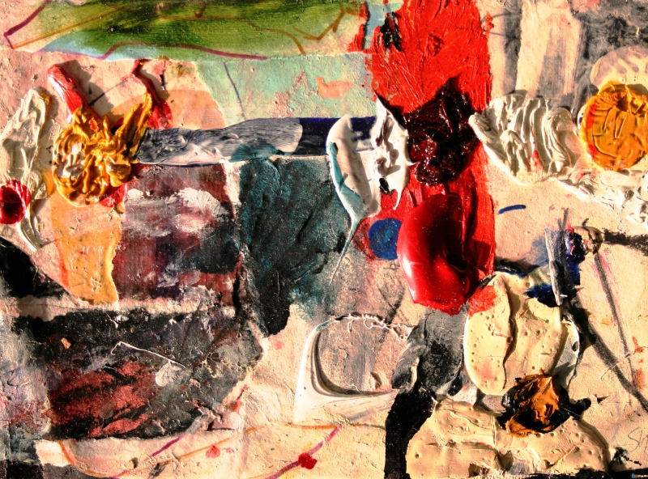
Blame worthinesss#5

Slide 7
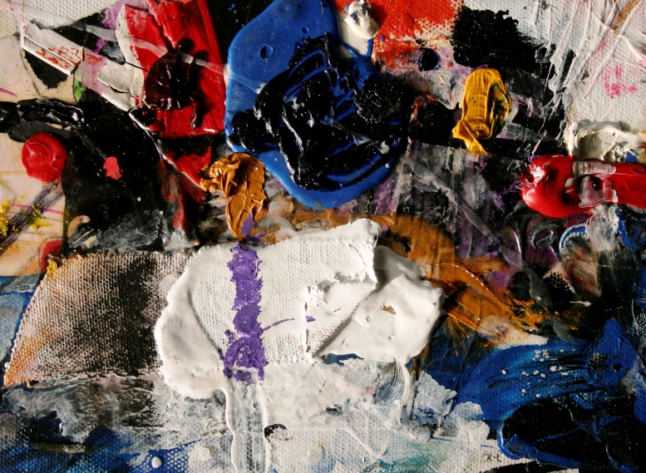
Blame worthiness#6

Slide 8
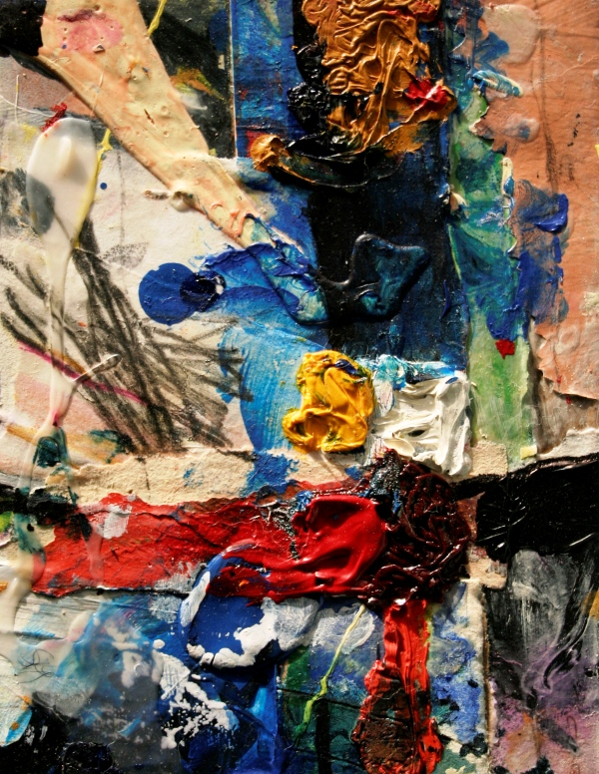
Blame worthiness#7

Slide 9
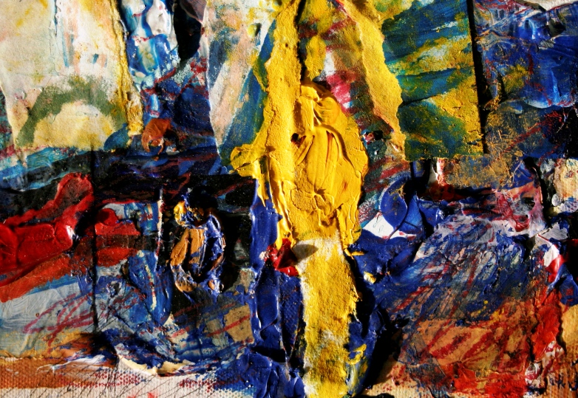
Blame worthiness#9

Slide 10
Contact information: susyharm@hotmail.com
All art works are 9”x12
Mixed media/canvas
2011

